Slide 1
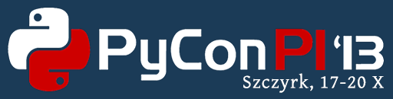
Writing standalone Qt & Python applications for Android workshop
Martin Kolman
Red Hat
http://www.modrana.org/pyconpl2013
martin.kolman@gmail.com
@M4rtinK

Slide 2
What you need
an Android device, or at least the Android emulator
the Necessitas NDK so that you can use pydroid
  or at least a normal Android SDK/NDK so that you have the adb utility available

Slide 3
pydroid - installation
git clone https://github.com/raaron/pydroid
cd pydroid
sudo python setup.py install
configure path to Necessitas NDK in ~/.pydroid/deploy.conf
check what pydroid can do
pydroid help
(also check README.md)
check if your system is correctly configured
pydroid status

Slide 4
pydroid - usage
create an example project
pydroid create example qt_components
edit stuff
deploy to device
pydroid deploy complete
after first deployment, fast deployment is available
pydroid deploy fast

Slide 5
Links
these slides & related stuff
  http://www.modrana.org/pyconpl2013
Necessitas NDK installer
  http://necessitas.kde.org/necessitas/necessitas_sdk_installer.php
pydroid project
  https://github.com/raaron/pydroid
“normal” Android SDK/NDK
  http://developer.android.com/sdk/index.html
  http://developer.android.com/tools/sdk/ndk/index.html

